Slide 1
Intellectual Output 1 Accessing Higher Education in Europe: Challenges for Refugee Students and Strategies to Overcome Them Mariana Arjona Soberón Lena Reuter Antonia Chibuzor

Slide 2
Description
This output will critically analyze and further develop admissions criteria established by European universities, it will look into preparatory programs for higher education that can serve as intermediary solutions for refugees on the road to integration in university degree programs.
The main interest group is refugee applicants looking to be admitted to an institution of higher education or seeking support from such an institution.

Slide 3
Objectives
Participating higher education institutions are better prepared to provide a humane and realistic path for integration in higher education.
To support university administrations at a European level by discussing and addressing commonly faced issues.
To level the playing field and chances of successfully integrating into higher education, regardless of the country of residence.
.

Slide 4
General Background
Primary education
only 50 per cent of refugee children have access to primary education, in contrast to a global average of 90 per cent
Secondary education
the gap becomes wider: just 22 per cent of refugee adolescents attend secondary school compared to a global average of 84 per cent
Tertiary education
At the higher education level, we observe that one per cent of refugees attend university when 34 per cent of youth around the world do so.

Slide 5
General Background
Humanitarian Response
Food
Shelter
Health
Food
Shelter
Health
Education

Slide 6
Study Objective & Method
Mixed Methods
Surveys
Interviews
Literature Review

Slide 7
Activity: Desk Study
A desk-study was developed were over 120 universities were researched based on their refugee related activities. The output of the desk study was a 46-page report detailing the refugee-initiatives of 39 European institutions. This desk study served as the groundwork for IO1.

Slide 8
Activity: Round Table Discussion
A round table discussion took place via-Skype, participating institutions were the University of Bergen, the VU Amsterdam, the University of Cologne, the Aristotle University of Thessaloniki and Piraeus University. The round table discussion was filmed and challenges surrounding, application procedures, language courses, and preparatory programs were discussed.

Slide 9
Activity: Online Survey for Universities
An online survey for universities was designed, where they were asked to provide information on contact they have had with refugee students, and any initiatives they may have, universities spoke about challenges and best practices in areas like admissions procedures, language courses, and financial aid and alternatives to traditional enrollment.

Slide 10
Activity: Online Survey for Students
Activity: Student Interviews
An online survey for students was designed, where they were asked to provide information on their experiences at the university and their challenges with their current educational journey.

Slide 11
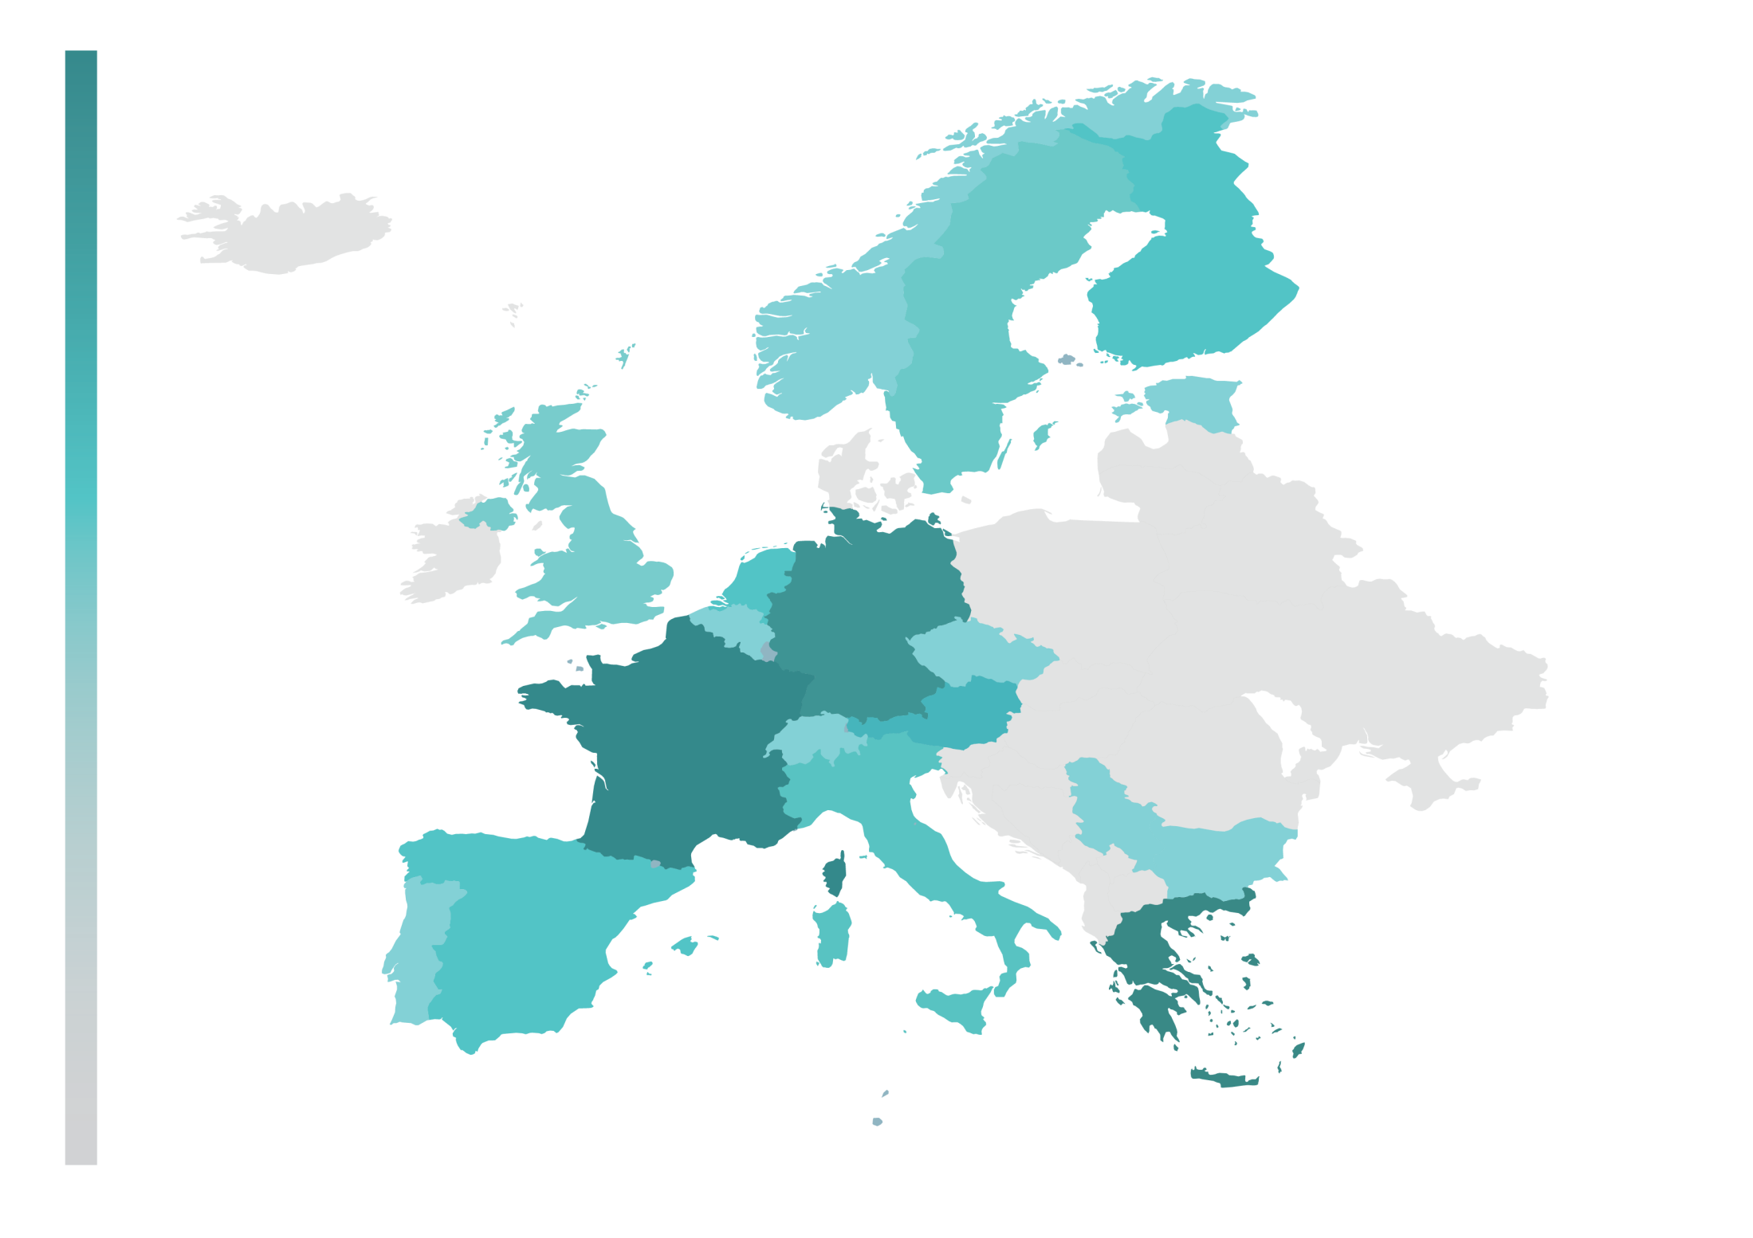
Geographic Profile: Universities

Slide 12
Geographic Profile: Students

Slide 13
Challenges and Best Practices PERSPECTIVE
Student
Personal
System
Interpersonal

Slide 14
Challenges and Best Practices FRAMEWORK

Slide 15
Transition Into Adulthood CHALLENGES & BEST PRACTICES
Suddenly Adult
Best Practices:
Comprehensive “all encompassing” Advising
Psychosocially Sensitive Advising
Staff Training
Human Perspective

Slide 16
Shifting Support Structures CHALLENGES & BEST PRACTICES
“In Syria, we get money from our parents, no student is working, you focus on your studies. Here, you only rely on yourself.”
“Each refugee student was supported by two students who helped to integrate into campus life and society as a whole.”
Best Practices:
Structured Buddy Programs
Long-term Advising

Slide 17
Information Barriers CHALLENGES & BEST PRACTICES
Finding the right kind of information
Ethnocentric Perspective
Best Practices:
Inclusive Informative Website
Make Use of Community Resources
Talk to and LISTEN to Refugee Students
Comprehensive Information About the Educational System

Slide 18
Linguistic Barriers CHALLENGES & BEST PRACTICES
The key challenge in the educational journey of refugee students.
“I don’t want to study for this (language) exam my whole life.”
Best Practices:
Language Courses
Translated Information
Multi-lingual Advisors

Slide 19
Non-Recognition of “foreign” Education CHALLENGES & BEST PRACTICES
“The main challenges are clearly the language, and the official documents needed for admission. They are often missing.”
Best Practices:
Transparent evaluation procedures
Alternative evaluation pathways
Respect and appreciation to applicants

Slide 20
Financial Barriers CHALLENGES & BEST PRACTICES
“Based on our experience, many students faced difficulties to follow courses mainly because they were still struggling with their personal material condition”
Best Practices:
Comprehensive Information About Funding Opportunities
Creative Funds

Slide 21
Lack of Administrative Harmonization CHALLENGES & BEST PRACTICES
“Informing the staff of new rules about accepting refugees in courses - having a common procedure”
Best Practices:
Transparency is the Best Policy
Create Clear Communication Channels
Grow Your Network

Slide 22
Intercultural Gap CHALLENGES & BEST PRACTICES
“Culture provides diverse ways of interpreting the environment and the world, as well as relating to other peoples. To recognize that other people see the world differently is one thing. To view their interpretations as less perfect than our own is another.”- F. Jandt, 2013
Best Practices:
Intercultural Communication Trainings
Feedback Sessions
Auditing Classes

Slide 23
Social Discrimination CHALLENGES & BEST PRACTICES
Intersectional discrimination
“on the basis of “race” and ethnicity, faith, sexual orientation, gender expression and identity, political belief and socio-economic status”
Best Practices:
Openness and Acknowledgement
Staff Training

Slide 24
Roadmap for Improvement FROM THEORY TO PRACTICE

Slide 25
Advice from Around Europe

Slide 26
Output

Slide 27
Intellectual Output 2 University Support for Refugee Students

Slide 28
Description
This output is concerned with refugee students that have successfully been admitted to a university program. All new students have a learning curve when adjusting to higher education. It is understood, however, that this student group may have additional challenges in navigating the European university structure be it because of language challenges, financial hurdles, cultural differences and the newness of the actual university structure. This output will look into the university structure and student support systems, to be able to identify and improve upon the needs of this particular student population.

Slide 29
Objectives
Participating higher education institutions are better prepared to provide continued support for refugee students through their academic journey.
To curb potential drop-out rates due to lack of institutional support.
To build bridges between communities by including European peers in the social integration efforts of refugee students.
To provide a visible and simple network that refugee students can turn to when in need of support.
.

Slide 30
Thank you!

