Slide 1

Multiplier Event
Thessaloniki, 15-18 March 2018
Πρακτικές στήριξης
και ένταξης των προσφύγων
SUCRE KA2 Project
Supporting University
Community
pathways for
REfugees-migrants
Alexandros Triantafyllidis
Assoc. Prof. School of Biology-AUTh, ECTS Coordinator,
Member of AUTh European Educational Programmes Committee

Slide 2
SUCRE: Supporting University Community pathways
for REfugees-migrants
Overall: SUCRE Programme focuses on
The processes that are required for the proper integration of refugees / migrants in Higher Education, as well as
For the support of their academic needs after their integration
The psychosocial integration / support of refugees / migrants and
The proper information provided to them on legal and medical issues
This program aims to create educational material that will be used properly by trainers for the above purposes
General Academic Support of the Project | Vice-Rector of Academic and Student Affairs, Dr. Ariadni Stogiannidou, Prof. at the School of Psychology.
Notes:
We need to say more things here, maybe explain them orally.

Slide 3




SUCRE Consortium
Coordinator: Aristotle University of Thessaloniki, Greece
Partners: Greek Council for Refugees, Greece
VU Amsterdam, The Netherlands
University of Cologne, Germany
Complementary activities
Unique expertise
Combination of HEIs with/and without Refugee experience
Institutions with direct access to Refugees, etc
Notes:
Few words about the University and they added value gained from it (details in the next few slides)

Slide 4
Aristotle University of Thessaloniki
its geographical position as an Institution in close distance with the pathways followed by the refugees and the borders of the Balkan routes chosen on their way to Central Europe
the expertise of the Institution on working with migrant, refugees and “minority groups” and
the initiatives already formed in several schools of the university in order to alleviate the refugees.
Additionally three of its departments have played a significant role in working with foreign students:
  the Department of European Educational Programmes is at the forefront of activities related to International Students
  the School of Modern Greek Language of AUTh.
  the IT Center of the Aristotle University of Thessaloniki providing modern, cutting-edge electronic services to the academic community of AUTh.
Studienstart International: Students from Non-EU countries have the opportunity to start their studies with a one-semester preparatory programme
Support for Scholars: The International Office’s department “International Science” helps refugee scholars find an occupation at the University of Cologne and it helps institutes, chairs and working groups who host refugee scholars find suitable candidates and apply for funding
Refugee Law Clinic: a project that supports immigrants, particularly refugees and asylum seekers. The project offers legal consultations free of charge and other support
PROMT: Independent of school form or subject, aspiring teachers studying at the UoC teach children and adolescents from refugee families as well as unaccompanied minor refugees in the framework of a practical internship
University of Cologne

Slide 5
VU Amsterdam
VASVU (1980), Foundation year for International Students. Although not exclusively, in practice it
is meant especially for refugee students. The objective of VASVU is to provide access to university
education for students living in the Netherlands who have had schooling abroad but no
direct entry into Dutch higher education.
The Vrije Universiteit programme on Academic Freedom plays an active role in the Netherlands
chapter of Scholars at Risk. They have started hosting scholars in 2009 and so far have
accommodated scholars from Iran, Iraq and Ethiopia. We have extensive experience networking
with other Dutch institutions, the Foundation for Refugee students UAF.
There is an extensive array of partnerships with similar programs in the Netherlands and
abroad and with organizations like the UAF and the EAN (European Access Network).
Greek Council for Refugees
The mission of the Greek Council for Refugees (GCR) is to promote the rights of asylum seekers and
refugees through the provision of legal and social services and advocacy work.
The Members of its Board are experts in the field of asylum, each covering different aspects of this
multi-disciplinary field. The Board consists of lawyers, a political scientist professor, retired UN
personnel members and a social anthropologist.
GCR has extensive experience in conducting training sessions to members of civil society, staff of
public sector bodies such as to members of the Asylum Service and the Appeals Committee, as well as
judges, on combating racist violence, implementing alternatives to detention, on rehabilitation services
for victims of torture, amongst other topics.

Slide 6

SUCRE’s Intellectual Outputs (IOs)
IO 1: Higher Education Qualification and Application Procedures for Refugee Applicants
  Overall:
  IO 1 will analyze and develop admissions criteria established by European Universities
  with the following objectives:
  To provide a humane and realistic path for integration in higher education
  To support universities’ administration at a European level and
  To assist the integration of refugees/migrants into higher education.
  Activities:
  Desk Study: Inventory of Recent Initiatives
  Interviews
  Workshop: Strategies for Integration in HE Through Language and Remedial Courses
  Round Table Discussion
  Deliverables:
  D1: “A guide for best practices that highlight and discuss successful strategies for integration in HE through language and remedial courses.”
  D2: Publication Part 1- “A summary handbook of critical lessons learned through not so successful strategies and ways to remedy and avoid these pitfalls in the future.”
  D3: Publication Part 2- “Best Practices” as well as the methodological framework used to assess and improve upon current strategies and to plan future interventions.”

Slide 7

SUCRE’s Intellectual Outputs (IOs)
IO 2: Institutional Support for Refugee Students in Higher Education
  Overall:
  IO 2 is concerned with refugee students that have successfully been admitted to a
  University programme. Its objectives are:
  To provide continued support for refugee students through their academic journey
  To curb potential drop-out rates due to lack of institutional support
  To provide a visible and simple network that refugee students can turn to when in need of support
  Activities:
  Desk Study: Inventory of Recent Initiatives
  Interviews
  Round Table Discussion
  Deliverables:
  D4: Publication Part 1- “A general plan for sustainable and comprehensive refugee student services, including, a university-wide quality assurance system.”
  D5: Publication Part 2- “A summary handbook of recommendations for the social integration of refugee students with their European peers.”

Slide 8

SUCRE’s Intellectual Outputs (IOs)
IO 3: Institutional Support for Refugee Scholars in Higher Education
  Overall:
  IO 3 is concerned with refugee scholars that will be hosted at a University department looking into the University structure and scholar support system in order to identify and improve the needs of the refugee scholars. Its objectives are the following:
  To provide support for refugee scholars during their academic stay
  To build bridges between academic communities by including European peers in the social integration efforts of refugee scholars
  Activities:
  Desk Study. Develop an inventory of recent initiatives for supporting refugee scholars in Europe
  Academic and Social Integration Discussion
  Deliverables:
  A digital/online guide of recommendations for refugee scholars integration

Slide 9

SUCRE’s Intellectual Outputs (IOs)
IO 4: Psychosocial Support through Communities’ engagement and mobilisation
  Overall:
  IO 4 aims at training key informants and assist the development and testing out of a Manual of Good
  Practices
  Objectives:
  To equip the trainers with better resources and skills in delivering quality psychosocial support to
  refugee youth and families in host communities
  To identify and recruit refugee community workers
  To build a training programme for key informants and University members
  Activities:
  Communities' engagement and mobilization
  Training of trainers programme methodology
  Integration and social cohesion
  Monitoring and evaluation of the psychosocial output
  Deliverables:
  A digital/online educational module and monitoring/recommendations guidelines for trainers regarding the psychosocial support of refugees
  A digital/online educational module and monitoring/recommendations guidelines of lessons on refugee integration and social cohesion

Slide 10

SUCRE’s Intellectual Outputs (IOs)
IO 5: Supporting refugees on Health and Law Issues
  Overall:
  IO 5 is concerned with the creation of a special module in relation to health and legal protection of refugee/migrants, based on Conventions and Directives on an International and European Level.
  Its objectives are as follows:
  To introduce/train trainees to the theoretical approaches that have been extensively used in the
  literature in order to understand the relevant legal framework at EU and national level
  To enable/train trainees to understand the existing health issues rights in regard to refugees
  and the available services at the reception country
  Activities:
  Developing training modules on issues related to legal services
  Developing training modules on issues related to health care services
  Developing training modules on issues related to health care and legal services
  Monitoring and evaluation of the legal/health support
  Deliverables:
  A digital/online module and monitoring/recommendations guidelines for trainers regarding health support of refugees
  A digital/online module and monitoring/recommendations guidelines for trainers regarding legal support of refugees

Slide 11
SUCRE Gantt Chart

Slide 12

SUCRE & Dissemination
Local level:
Newsletters, social media, networking channels, conferences, seminars, workshops, etc
National level:
Presentation of activities, scientific conferences, publication
Through a database of stakeholders, NGOs. Municipalities, Ministries, EU agencies, etc
SUCRE & Sustainability
Construction of Digital Open courses material to be used by interested parties
First Organised Effort of Greek University – Setting the path for other interested Universities
Results will be used by other Universities and stakeholders
Long term initiative to build upon future applications

Slide 13
SUCRE & Dissemination
Important milestones
Discussions with the Gen Secr. Of The Greek Ministry of Education
Communication with Refugee Law Clinics Deutschland
Collaboration with Doctors of the World
Discussions with the Municipality of Thessaloniki and Prefecture of Macedonia
Outreach to Education Coordinators in refugee welcome spots
Successful Multiplier Event in Cologne (Sep 2017)
Presentation of IO3 at Scholars at Risk Conference (April 2018, Berlin)
3rd Multiplier event in Amsterdam (July 2018)
Final Press Conference in Thessaloniki (September 2018)

Slide 14
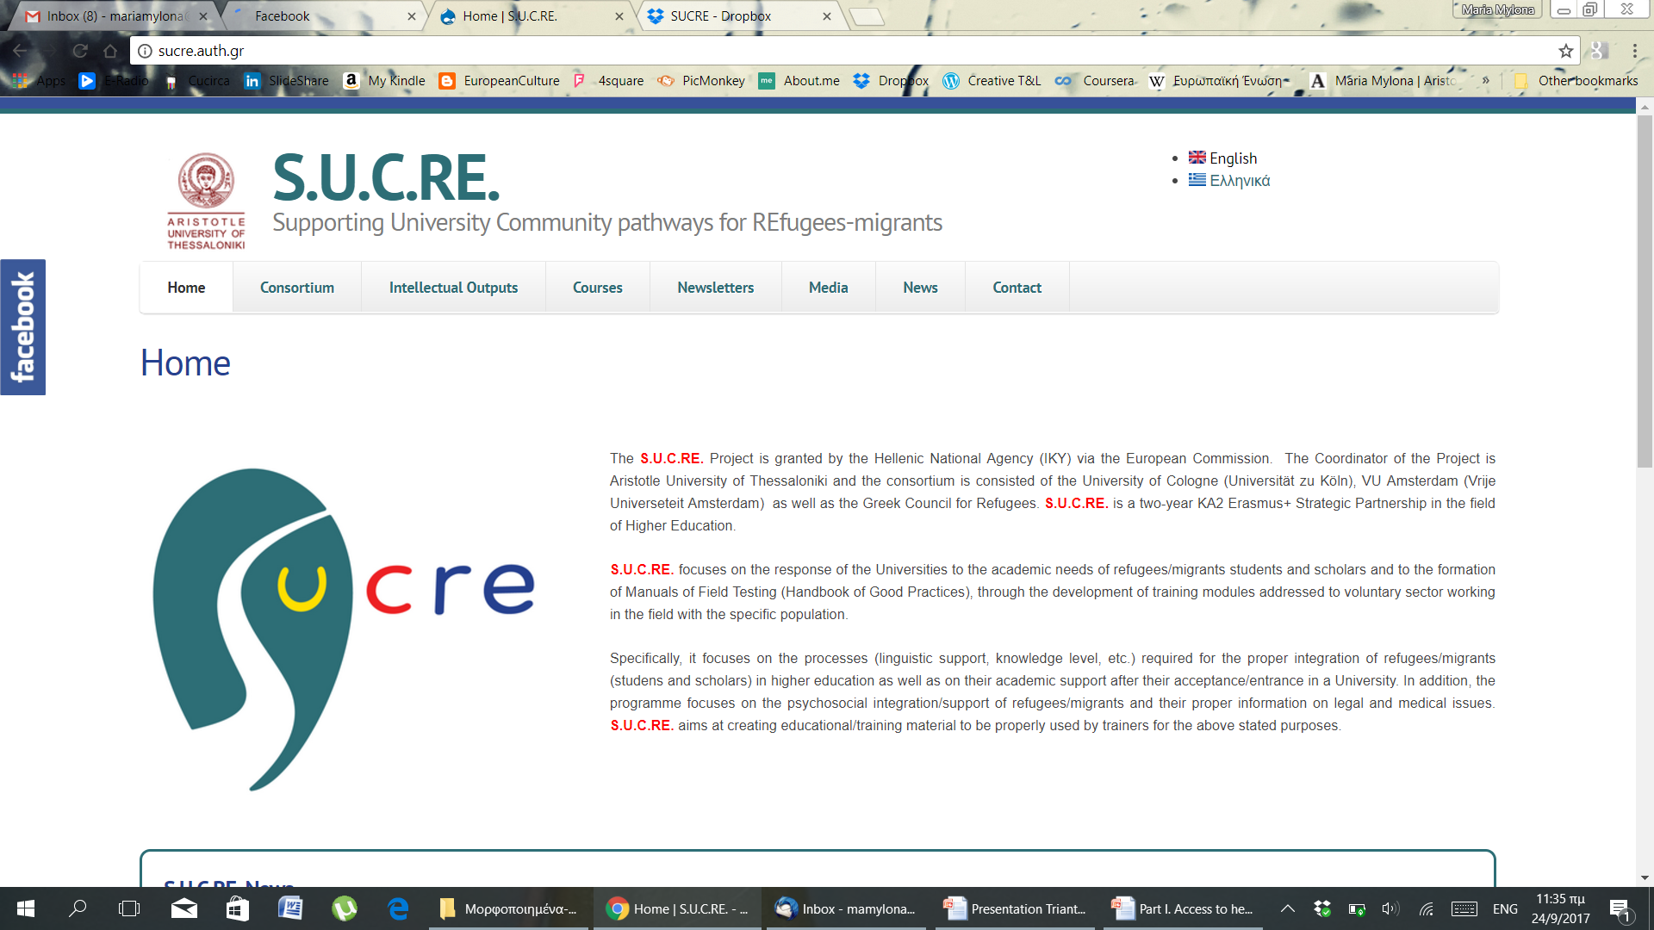
SUCRE’s Website & Facebook

Slide 15
SUCRE & Dissemination
MULTIPLIER EVENT ON IO4 and IO5
This training activity will focus on Intellectual Outputs O4 and O5. It will be addressed to end users of
the respective IOs (i.e. cultural mediators/ municipality and voluntary sector agents, university students, voluntary sector/ municipalities, lawyers, medical doctors or political scientists with previous training
in refugee law).
Key staff members of the AUTh and partners will be involved in designing and teaching during the
seminar
Partners will work on activities 1, 2 and 3 upon knowledge and skills that the trainees are likely to use
in practice.
Participants will also contribute to the evaluation of the deliverables

Slide 16
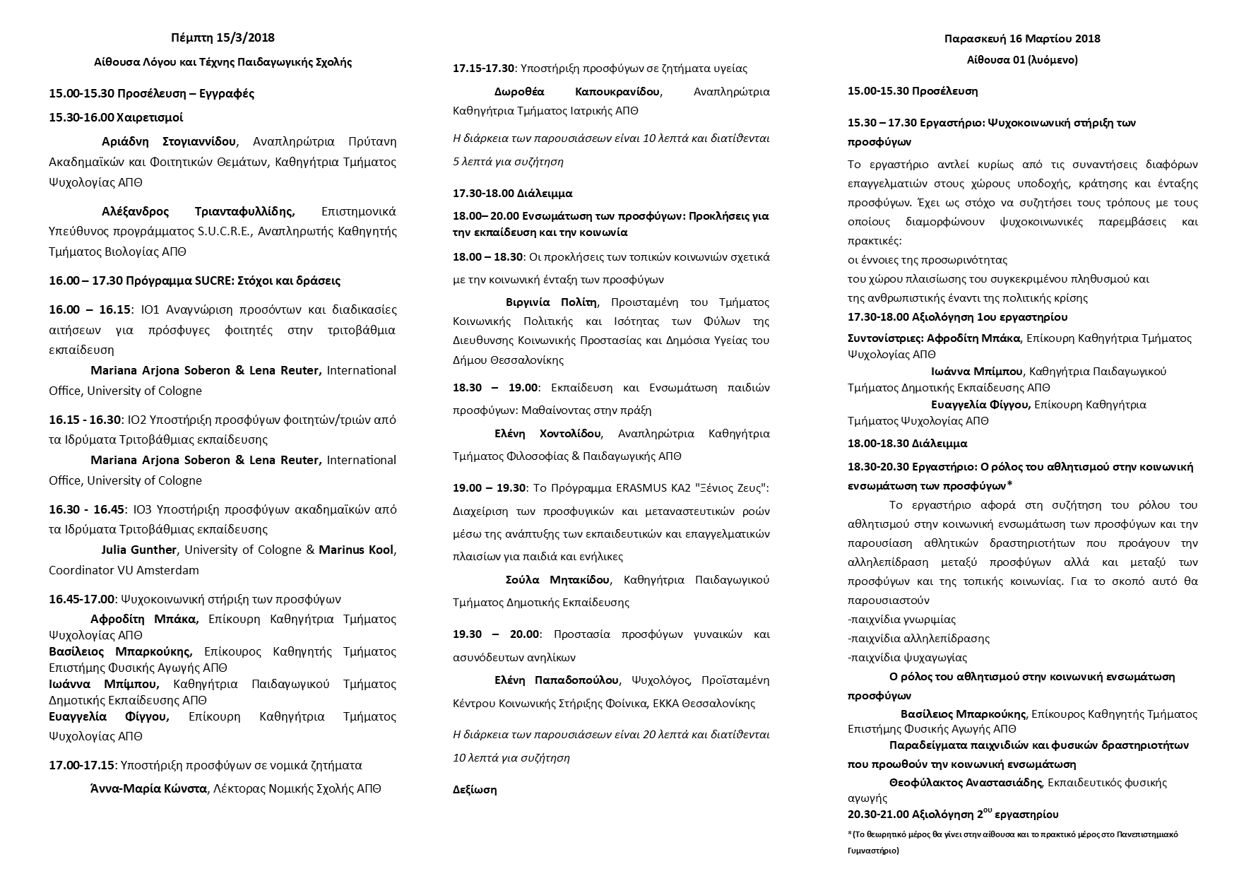

Slide 17
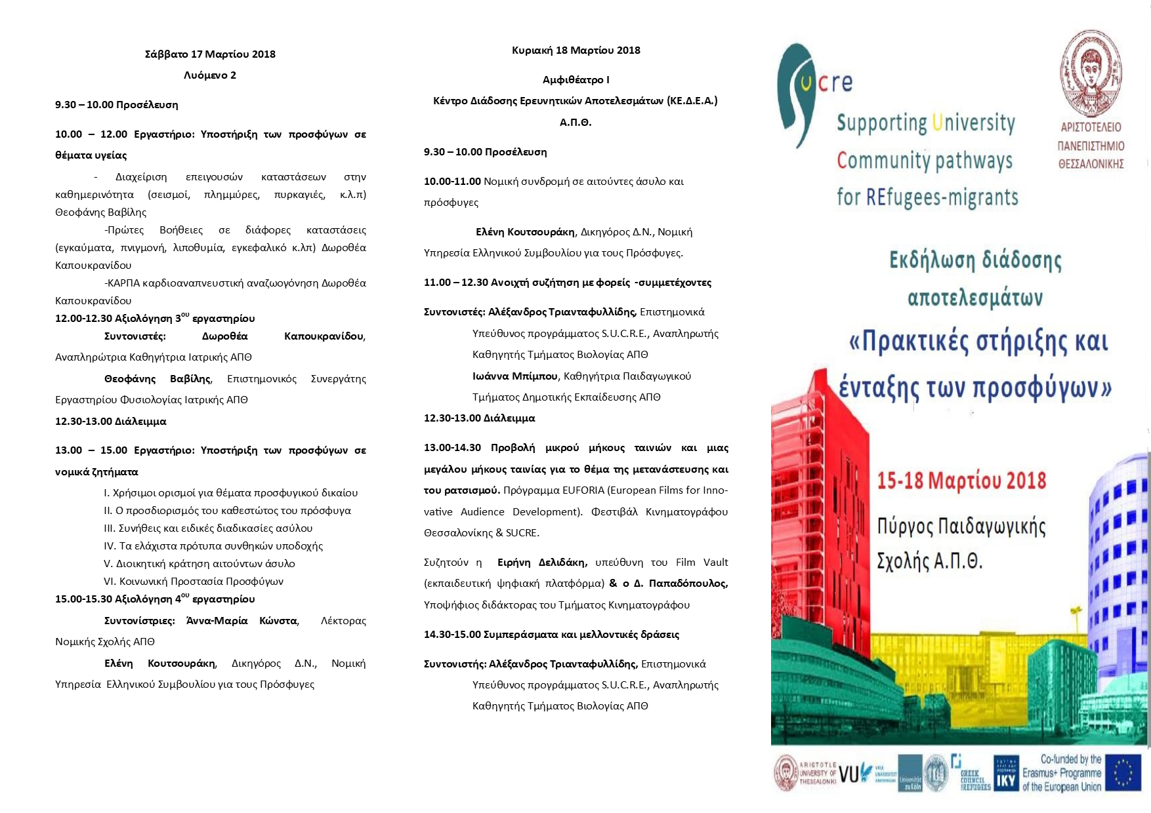

Slide 18
Σας ευχαριστούμε!!!

