Slide 1
Obay Hadid Co-Founder
“A good start is half way to success!”

Slide 3
Notes:
Story about Facebook groups (no other opportunity to get infos, more and more people, web 2.0 = fake comments) Privacy issues
Experienced Syrian People gathered to avoid the fake comments

Slide 4
Notes:
Archieving every thing on your account
Privacy issues are avoided
knowledgeable advisors with the mother language ! (mention the two professors about the freedom to talk on the mother language

Slide 5
Data from 23.04.2016 to 27.09.2017
Answered Questions
4,713
Registered Users
2,334
Articels' Views
133,510
Website's Visits
288,636

Slide 6
Notes:
Allow me to show you our website

Slide 7
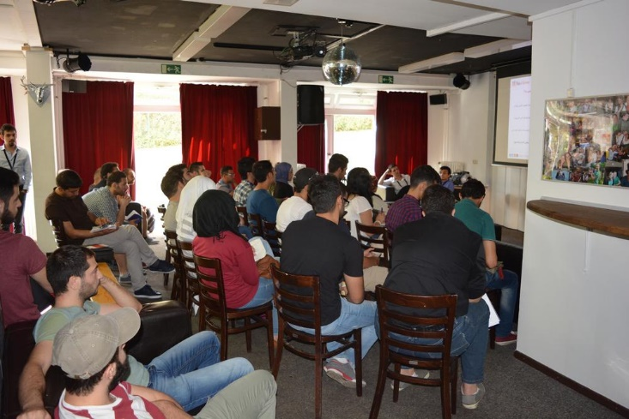
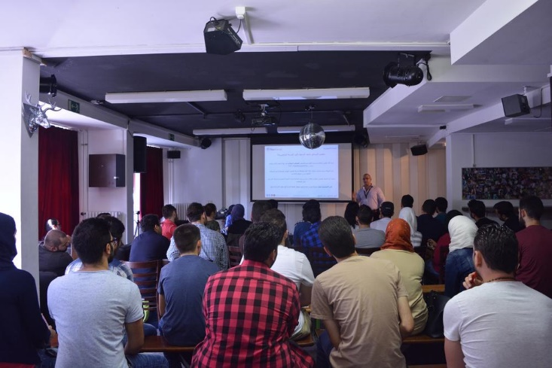
First Workshop in Berlin, 23.09.2016

Slide 8
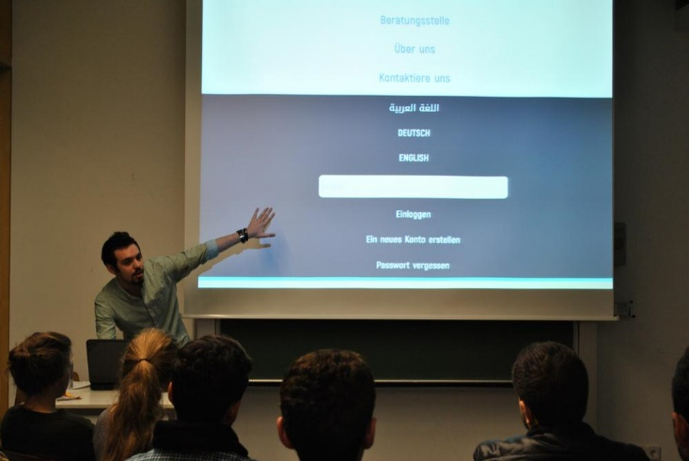
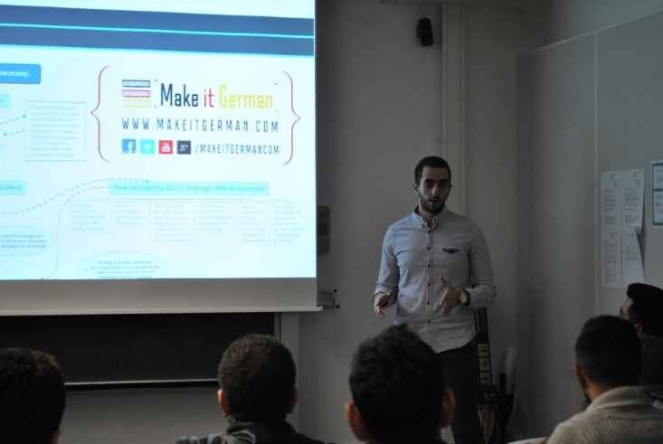
Workshop in Mannheim, 14.12.2016

Slide 9
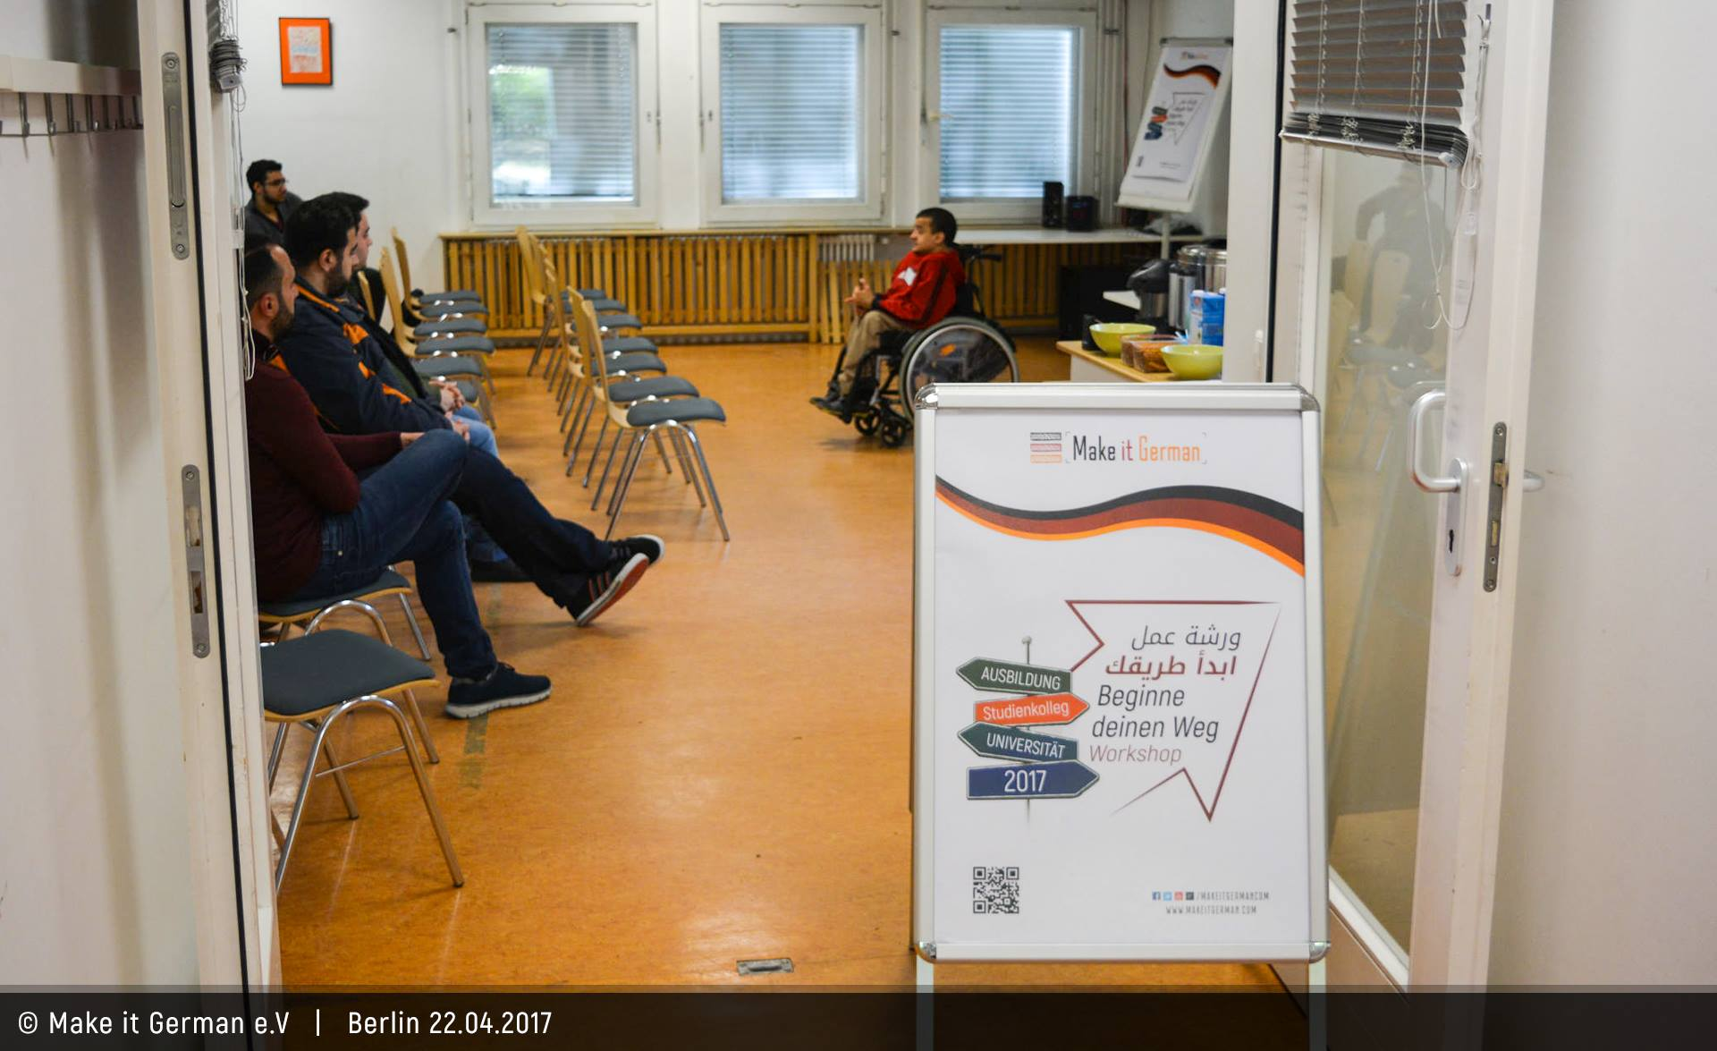
Workshop in Berlin, 22.04.2017

Slide 10
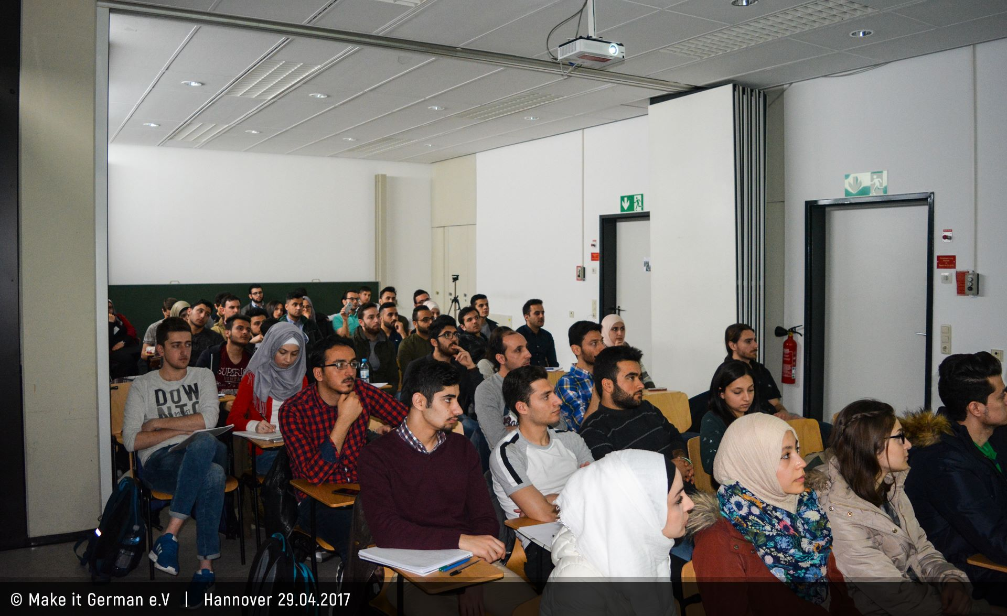
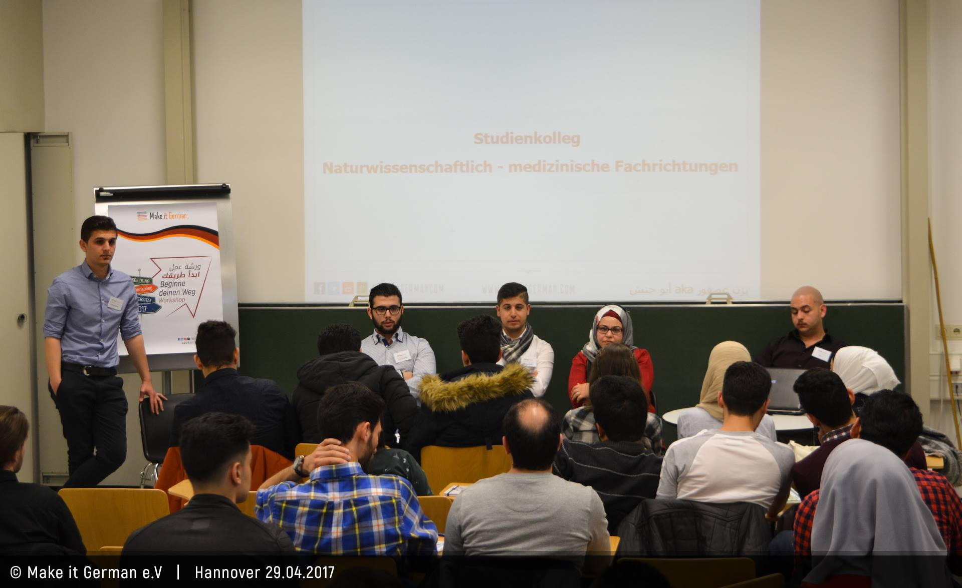
Workshop in Hannover, 29.04.2017

Slide 11
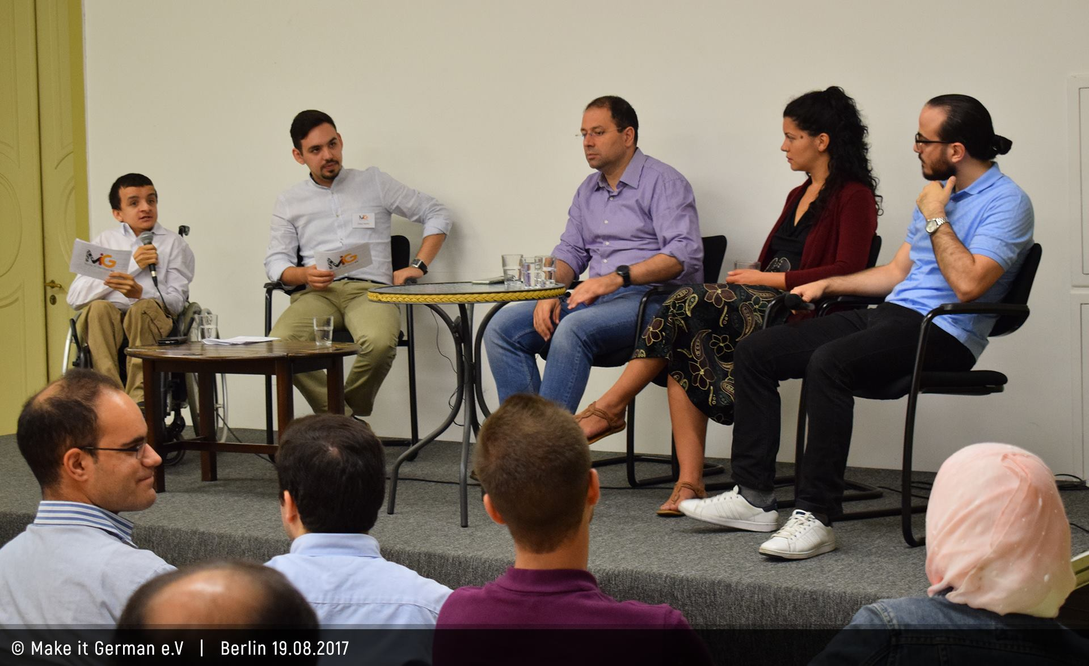
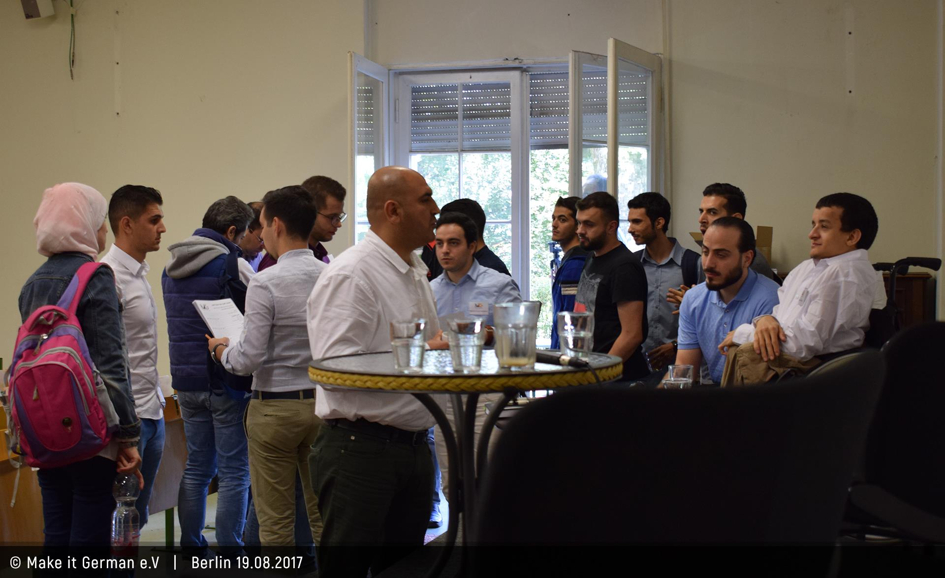
Workshop in Berlin, 19.08.2017
Notes:
(German Job Market)
New way to reach the people (Conference not a presentation)
We have posted the Reportage yesterday on FB

Slide 12
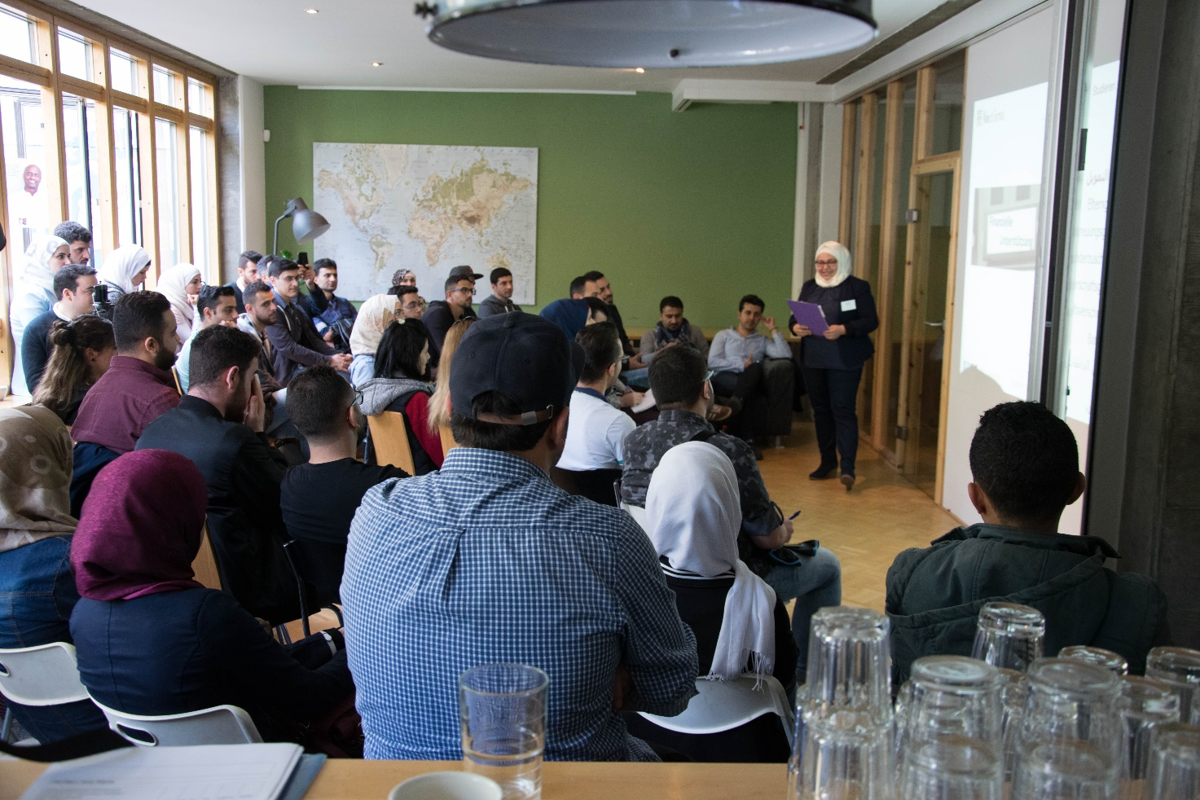
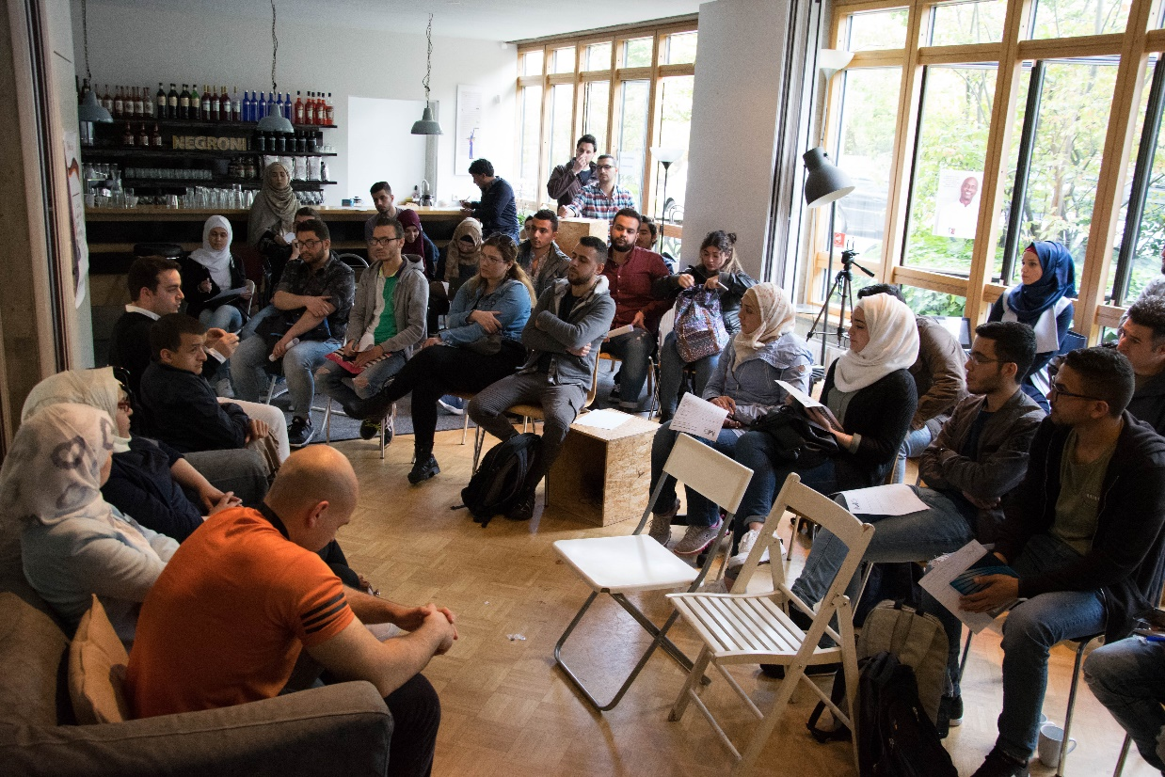
Workshop in Hamburg, 23.09.2017

Slide 13
Social Media Contents
Notes:
Among other things we do such posts to keep our people interested in our Project
And a lot other interesting things..

Slide 15
Notes:
Challenges:
-Financial difficulties ( small donations )
-No cooperative Universities
-We had to pay for rooms
-We can’t make new big projects we are planning for

Slide 16
Notes:
Rooms for Free
E-Mail us with the new Language courses, to share it
Contact Person to answer the critical questions related to each Uni

Slide 17
Obay Hadid
obay.hadid@makeitgerman.com
+4915754111895

