Slide 1
European Qualifications Passport for Refugees
Einar Meier
Senior adviser
NOKUT (Norwegian Agency for Quality Assurance in Education) Norwegian ENIC-NARIC

Slide 2
Lisbon Recognition Convention (1999)
Only legally binding text in the EHEA
Article VII: Legal obligation to develop procedures to assess qualifications of refugees
For access to HE/employment
Even where qualifications cannot be proven through documentary evidence.
Notes:
Each Party shall take all feasible and reasonable steps within the framework of its education system and in conformity with its constitutional, legal, and regulatory provisions to develop procedures designed to assess fairly and expeditiously whether refugees, displaced persons and persons in a refugee-like situation
fulfill the relevant requirements for access to higher education, to further higher education programmes or to employment activities, even in cases in which the qualifications obtained in one of the Parties cannot be proven through documentary evidence.
Important for integration and empowerment

Slide 3
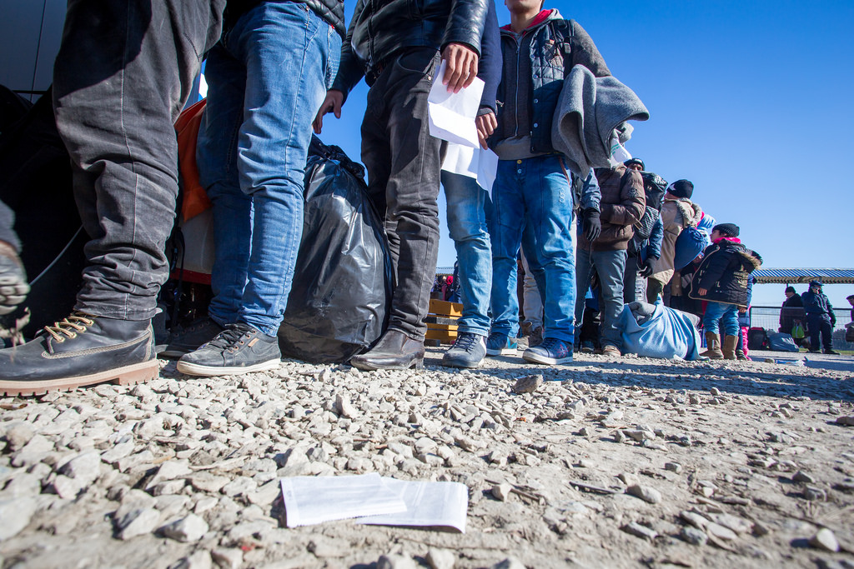
Challenges
Number of refugees
Language competency
Unfinished or undocumented qualifications
Demand for mobility and portability
Notes:
What kinds of solutions do we need:
Early / Fast
Effective
Accessible
Professional
Fair / provides equal treatment
Provides relevant information
Provides feasible system for transition and easy mobility between regions, educational levels and even countries
Current refugee crisis concerns all European states, but:
Different legislations
Different assessment practices
Different financial capacity situation
Different number of refugees

Slide 4
Towards a multilateral solution: European Qualifications Passport for Refugees
Aim:
Provide refugees with
An assessment of qualifications that cannot be fully documented
An assessment accepted across borders
Notes:
September 2015: Norwegian ENIC-NARIC (NOKUT) and UK NARIC proposed the idea of a European Qualifications Passport for Refugees, inspired by the Nansen Passport for refugees (look this up).
Feb-June 2016: Pilot project in Norway testing the methodology (20 refugees)
March – December 2017: Pilot project in Greece by the Council of Europe and Greek authorities in cooperation with UNHCR and recognition experts from Greece, Italy, Norway and UK

Slide 5
Task:
Map educational level, work experience and language proficiency
Provide information relevant for employment, internships, qualification courses, HE admission
Method:
Assessment of available documentation
Structured interview by qualified credential evaluators
Notes:
Task: to map, summarize and present available information on the applicant’s educational level, work experience and language proficiency, in order to provide information that can be relevant to applications for employment or internship, qualification courses and admission to studies.
Method – combination of an assessment of available documentation and a structured interview, conducted by a qualified credential evaluator, identification of missing documentation by use of previously evaluated cases

Slide 6
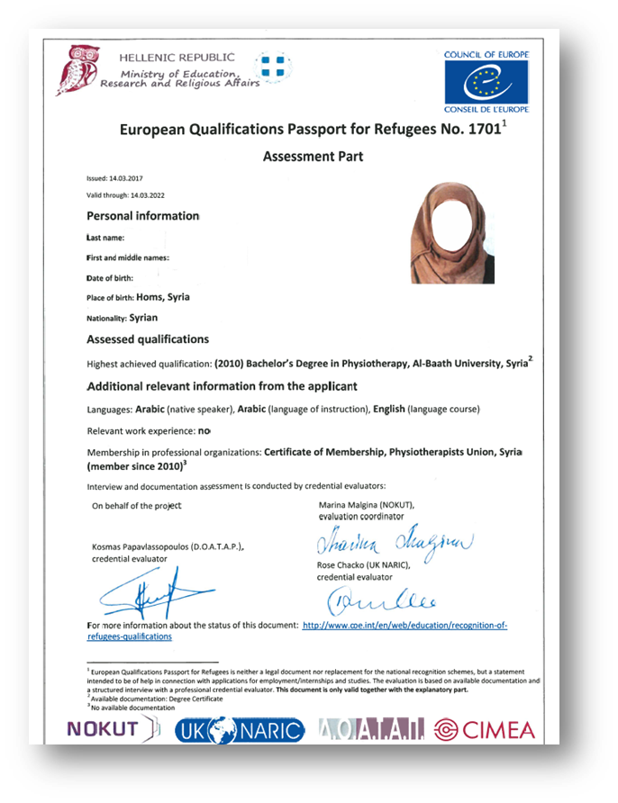
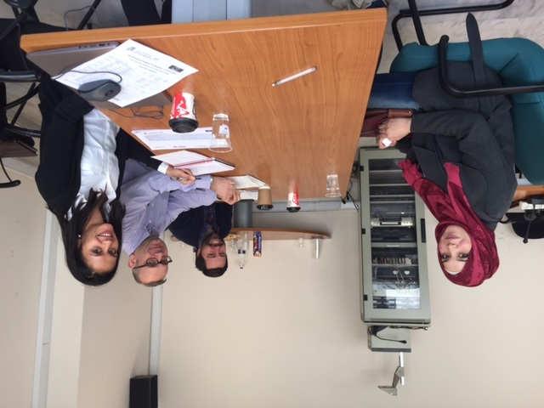
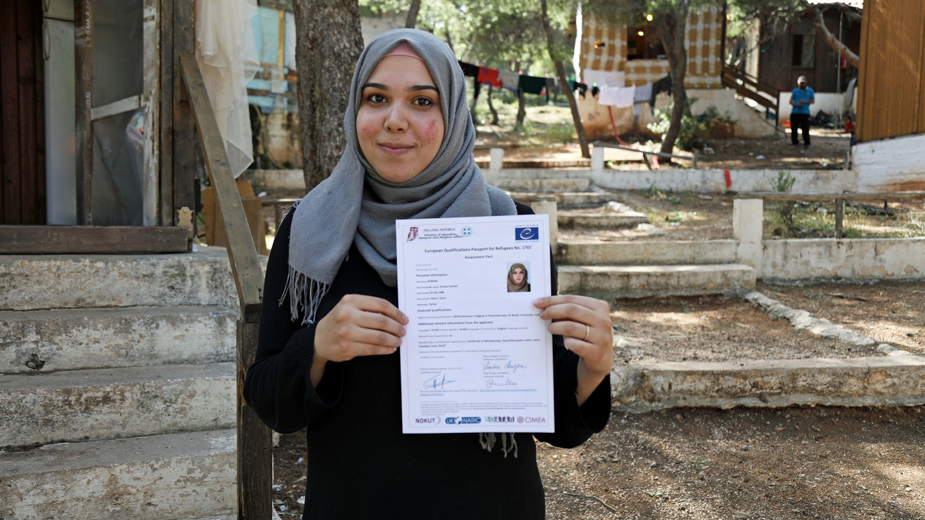
Outcomes: European Qualifications Passport for Refugees
Notes:
Outcome: European Qualifications Passport for Refugees, containing the following information:
Highest educational qualification achieved: Official name of the study/degree, field of study/specialization, educational institution, country
Other qualifications: Official name of the study/degree, field of study/specialization, educational institution, country
Additional relevant information: Languages – native speaker, language of instruction, others
Work experience and membership in professional organizations

Slide 7
Results so far:
62 refugees interviewed (+32 this week)
54 European Qualifications Passports for Refugees issued
Refugees interviewed in Greece have been relocated to Norway, Germany and Ireland – more are in process of relocation

Slide 8
The way ahead
NOKUT is coordinating an Erasmus+ project to develop a toolkit for recognition of refugees’ qualifications
EQPR II project 2018 (TBD): closer cooperation with HEIs?
Subsidiary text to Lisbon Recognition Convention
Methodology can be applied to other similar processes, e.g. identification of the potential students, qualified personnel in a special field of study etc.
Notes:
Continue our close cooperation with Norwegian HEIs in Akademisk dugnad, bridging programs, working groups, StAR etc.

Slide 9
More on the EQPR project
www.coe.int/en/web/education/recognition-of-refugees-qualifications
Greece is pioneering ‘education’ passports for refugees (World Economic Forum video)

Slide 10
Thank you for your attention!
Questions, comments or advice? Please get in touch!
Marina Malgina, head of section marina.malgina@nokut.no
Einar Meier, senior adviser einar.meier@nokut.no
www.nokut.no
NOKUT - Norwegian Agency for Quality Assurance in Education
Norwegian ENIC-NARIC

