Slide 1
Building bridges.
Presenting the Refugee Law Clinics in Germany
Maximilian Oehl
Chairman

Slide 4
(c) Refugee Law Clinic Hanover

Slide 6
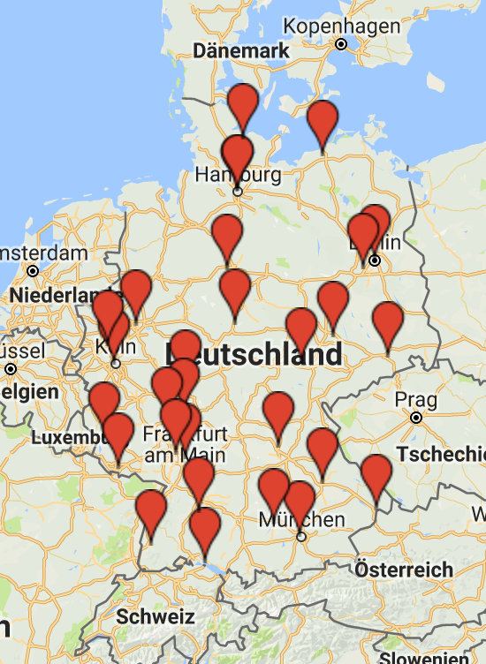

Slide 7
Our partners

Slide 8
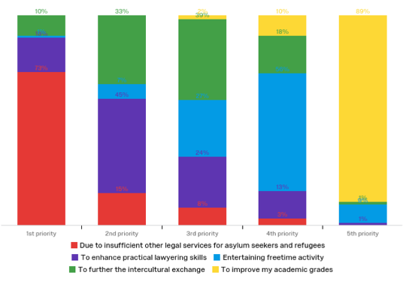
Our motivation
Study by Jan-Niklas Sievers. To be published in late 2017.

Slide 9
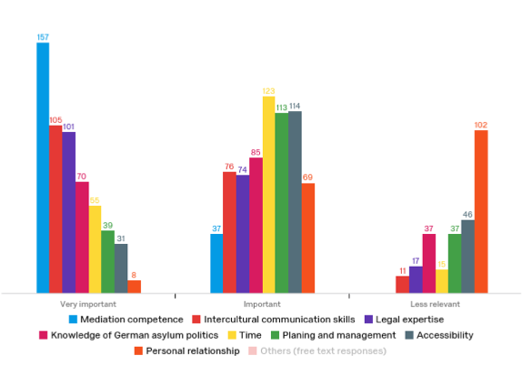
Most important skills
Study by Jan-Niklas Sievers. To be published in late 2017.

Slide 10
Thank you!
Follow us: @LawClinics
oehl@rlc-deutschland.de

